Slide 1
Back to School Night
2022-2023
Mrs. Novick
SECOND GRADE
TRACK C
Notes:
1

Slide 2
About Me
Mrs. Novick
Professional Experience:
Bachelor of Arts, University of California, Riverside
Master’s Degree in Curriculum and Instruction, Cal State San Bernardino
Special Ed Credential
Married with 5 cats and 2 dogs
22nd Year Teaching
Notes:
2

Slide 3
Goals for the Year
Have every student reach or exceed Common Core State and District standards.
Provide a safe, fun-filled, nurturing learning environment where children thrive.
Increase each child’s academic success in all subject areas.
Develop students’ organizational skills and sense of responsibility.

Slide 4
Expectations
Get a good night's rest and eat a healthy breakfast.
Students come to school by 7:50 and are with the teacher at 8:00 PREPARED TO LEARN.
Make illness the only excuse for absences.
Complete classwork and homework assignments on time.
Read 20 minutes every day in addition to regularly assigned homework.
Memorize math facts to automaticity (study nightly).

Slide 5
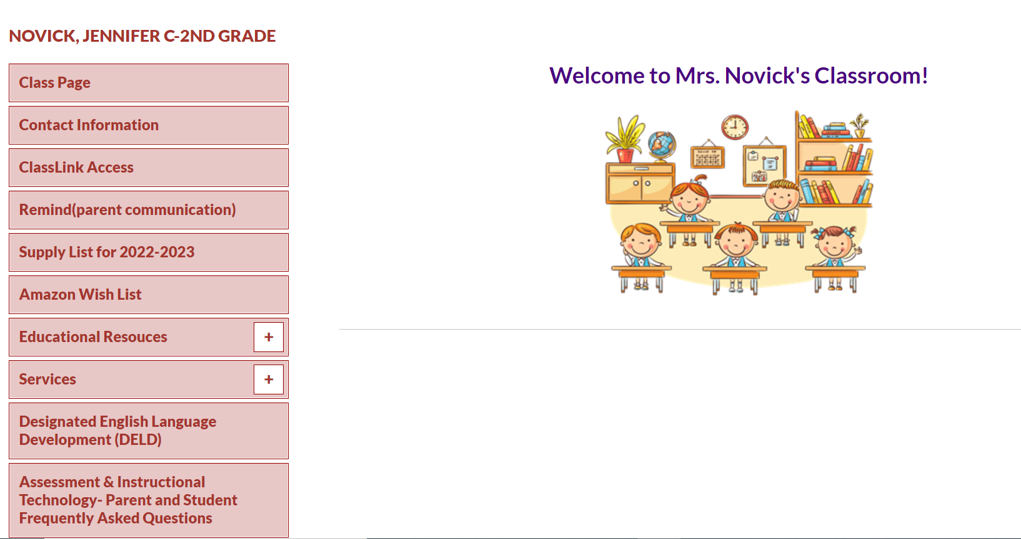
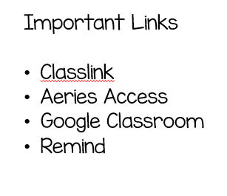
Class Website
Access my website via Cal Aero Website under the classrooms tab.

Slide 6
Classwork
It is important that each student completes his/her classwork. If classwork is not finished in the time allotted, the student may have to complete it at the during recess or at home. Make sure to check your child’s unfinished work section of his/her Aviator folder for any unfinished work nightly. To ensure that students always do their best, they may be asked to do an assignment over.
Notes:
6

Slide 7
McGraw-Hill Reading Wonders
ELA Curriculum
Focus will be on:
Vocabulary Instruction
Reading Comprehension Skill Development
Phonics
Spelling
Grammar
Writing
Writing Domains:
Informational
Narrative
Opinion
Online Access:
Online access for students and parents can be found on your child’s ClassLink account.

Slide 8
Math Curriculum Savvas Envision Math
Focus will be on:
Operation and Algebraic Thinking
Numbers and Operations in Base Ten
Measurement and Data
Geometry
Online Access:
Online access for students and parents can be found on your child’s ClassLink account.
Supplemental programs utilized daily on Chrome books in class.
Prodigy
Extra Math

Slide 9
Other Core Subjects English Language Development (ELD)​ - Remediation, Intervention & Enrichment​ - Social Studies- Houghton Mifflin-NGSS​ - Science- Twig- NGSS(\(99999999 - P.E. – Appropriate shoes​ - Music- Once a week​ -Library

Slide 10
Grading Policy
All grades are a combination of class work, tests, quizzes, class participation, homework, and/or teacher observation.
Notes:
10

Slide 11
Grading Scale
Grade/Number | Meaning
4- Excelling | Student is at the Excelling level of performance. They have an in-depth understanding of grade level performance standards expected at this point in the school year.
3- Achieving | Student is at the Achieving level of performance. They are consistently meeting the grade level performance standards expected at this point in the year.
2- Progressing | Student is at the Progressing level of performance. They are partially meeting the grade level performance standards expected at this point in the year.
1- Beginning | Student is at the Beginning/Standard Not Met level and is not yet meeting grade level performance standards expected at this point in the year.
Standards Based Grading Report Card, resulting in students receiving the grades of 1, 2, 3, and 4.

Slide 12
Homework*
District guidelines are 20-30 focused minutes daily as well as an additional 20 minutes a day of outside reading.
Homework will be assigned Monday through Thursday.
1. Read: 20 minutes. Reading Log due each Friday.
2. Math: Math Homework Book Worksheet due next day.
3. Unfinished classwork.
4.Test prep when necessary.
Notes:
12

Slide 13
Absences
Please make sure your child is in school unless ill.
ATTENDANCE COUNTS!
Please try to schedule appointments after school. If you are taking your child out of school, please let me know ASAP. Work missed will need to be completed.
Missed tests will be given the next day the student returns or when time permits.
TARDIES do count against perfect attendance!
Notes:
13

Slide 14
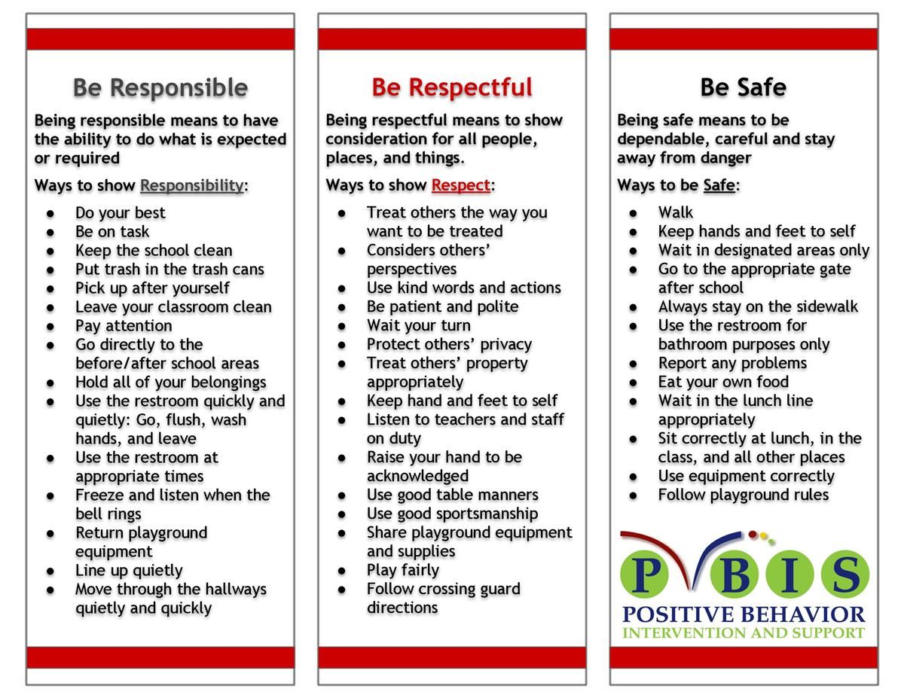
School Wide Behavior Expectations
Rick Morris Behavior Clionstrates exemplary behavior hone call home, email, or notification on daily behavior calendar.

Slide 15
Incident Logs
Incident Logs are used for OUTSIDE minor playground offenses.
Examples: running before, during, or after school, pushing, playing after bell, using bathroom after the bell …
Parent signature REQUIRED
Grades 1-6
Incident Logs will warrant the following consequences (per trimester):
1st: Warning
2nd: Loss of a recess and citizenship grade on the report card lowered one level
3rd: Office referral for 1 lunch detention
4th: Parent/Student/Teacher Conference with an Administrator

Slide 17
Behavior Expectations in Class
Be Responsible
Be Respectful
Be Safe

Slide 18
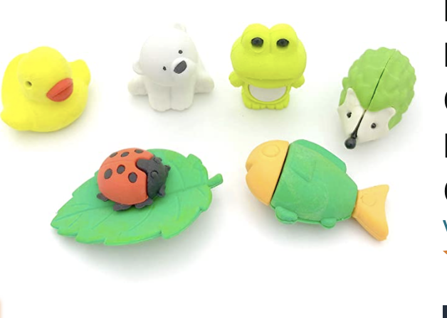
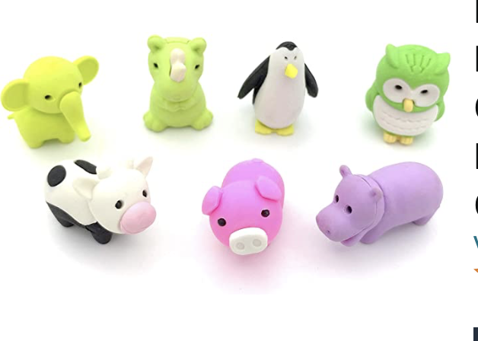
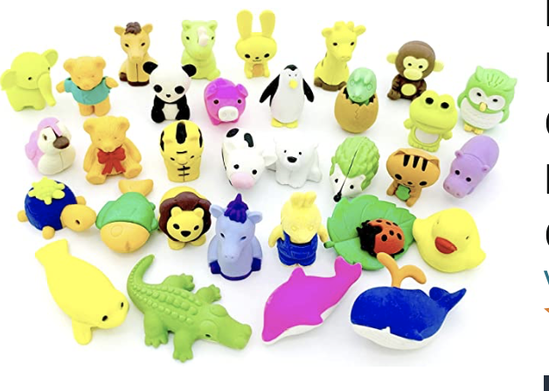
Behavior Expectation Rewards
Student’s will earn AIM High points for positive behavior both in the classroom and on the playground.
Students will be able to redeem points to purchase DESK PETS!

Slide 19
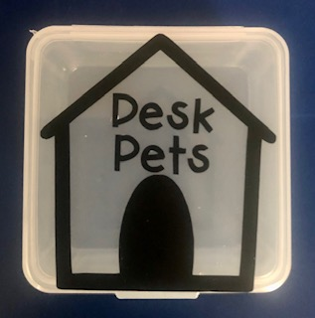
How does my student earn a Desk Pet?
Follow directions quickly.
Be kind with words and actions.
Be ready to learn and have all necessary materials.
Stay focused in line. Stay distance and walk with a purpose.
Stay on task and complete class work.
When students do these things, they can earn up to 5 points a day! “Marley’s Pet Shop”
will be open approximately every two weeks.
Students can buy; pets, accessories, food for their pets, and supplies to build their pet’s habitat.

Slide 20
Student Recognition
There will be 3 awards assemblies this year.
Top Flight
Captain
Lieutenant
Perfect attendance (no absences, and no more than 2 tardies or leaving school early)

Slide 21
We’re College Bound! Graduating Class of 2037!
University of Hawaii
Wear College Bound shirt every Monday and
Aviator shirt on Fridays!
Notes:
21

Slide 22
Birthdays
►Birthdays will be celebrated in class with a birthday song and dance.
►NO treats or goodie bags allowed.

Slide 23
School Supplies
Please replenish necessary school supplies throughout the year as needed.
Pencils, Paper, Crayons, Glue Sticks, etc.
Notes:
23

Slide 24
Classroom Donations
White copy paper (8 ½ x 11)
Colored Copy Paper
Tissue Paper
Expo Markers
Pencils
Amazon Gift Cards
Amazon Wish List (DeskPets) Located on my classroom webpage.

Slide 25
Parent-Teacher Conferences are coming up.
9/6 - 9/9
These are minimum days!
Please sign up for a date/time on Sign-Up Genius on our classroom web page. Sign ups are available now!!!
Notes:
25

Slide 26
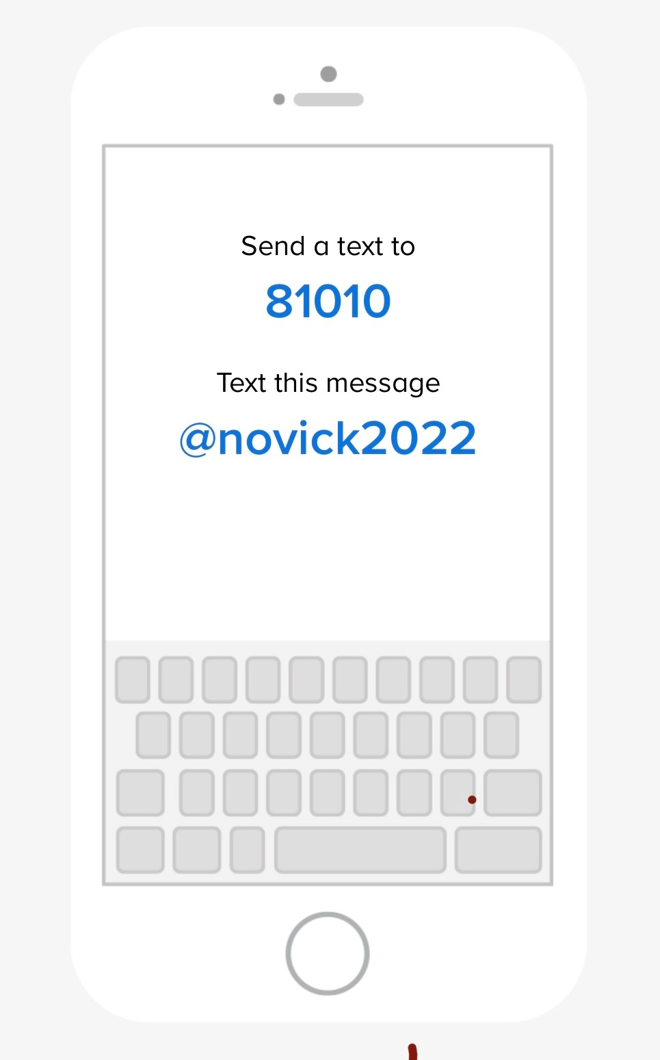

Slide 27
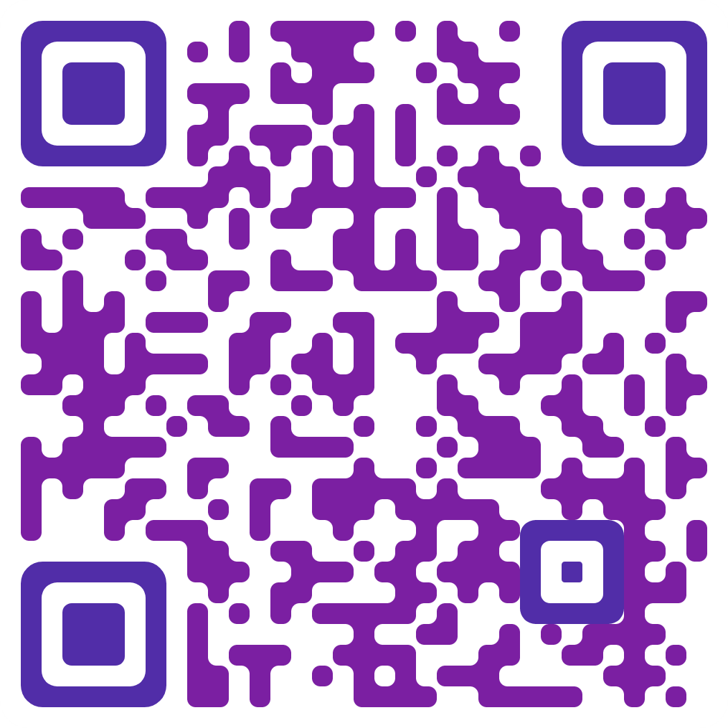
Classroom Wishlist
Raz-Kids
https://www.raz-kids.com
Online guided reading program with interactive ebooks, downloadable books, and reading quizzes.
Amazon Classroom Wishlist
$ 118.00 yearly.
Requesting
$ 5.00 per student
Already purchased
Requesting
$ 5.00 per student
@Jennifer-RandolphNovick

Slide 28
Contact Information
Please feel free to send me a note or an email regarding any questions or concerns.
Cal Aero Preserve (909) 606-8531
Jennifer_Novick@chino.k12.ca.us
I’m looking forward to a terrific year!
Thank you ☺
Notes:
28

